Slide 1
CSE 3105
Software Engineering

Slide 2
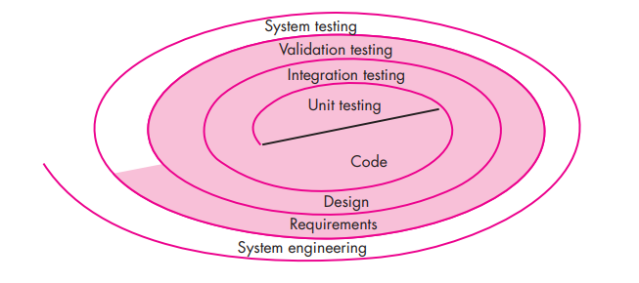
Testing Strategies

Slide 3
Misconceptions
(1) The developer of software should do no testing at all
(2) The software should be “tossed over the wall” to strangers who will test it mercilessly
(3) Testers get involved with the project only when the testing steps are about to begin.

Slide 4
When testing is over?
You’re never done testing; the burden simply shifts from you (the software engineer) to the end user.
You’re done testing when you run out of time or you run out of money.

Slide 5
Strategic Issues
Specify product requirements in a quantifiable manner long before testing commences
State testing objectives explicitly
Understand the users of the software and develop a profile for each user category
Develop a testing plan that emphasizes “rapid cycle testing.”
Build “robust” software that is designed to test itself
Use effective technical reviews as a filter prior to testing
Conduct technical reviews to assess the test strategy and test cases themselves
Develop a continuous improvement approach for the testing process

Slide 6
Verification:
“Are we building the product right?”
Validation:
“Are we building the right product?”

Slide 7
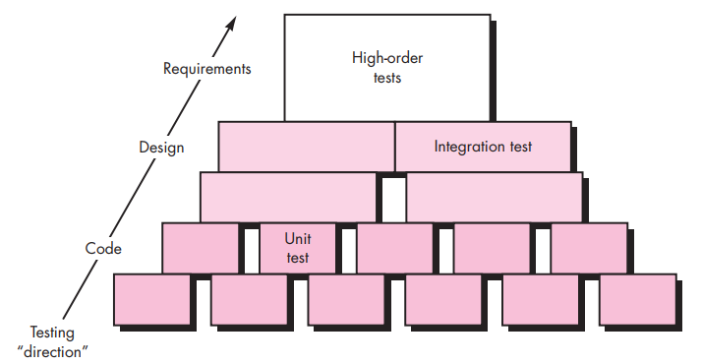
Testing Steps

Slide 8
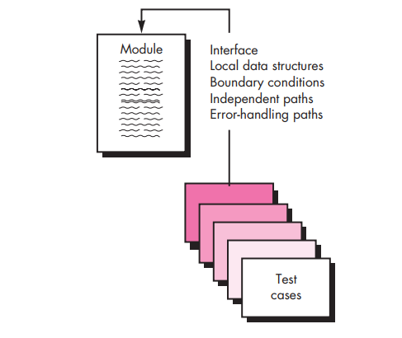
Unit Testing

Slide 9
Interface: To ensure that information properly flows into and out of the program unit under test
Local Data Structures: To ensure that data stored temporarily maintains its integrity during all steps in an algorithm’s execution
Independent Paths: To ensure that all statements in a module have been executed at least once.
Boundary Conditions
Error Handling Paths

Slide 10
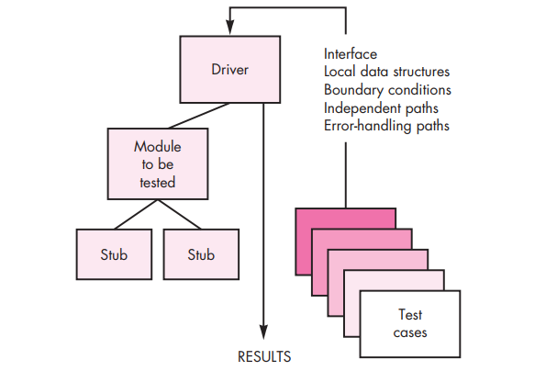

Slide 11
Integration Testing
If they all work individually, why do you doubt that they’ll work when we put them together?

Slide 12
Integration Testing
Data can be lost across an interface
One component can have an inadvertent, adverse effect on another
Subfunctions, when combined, may not produce the desired major function
Individually acceptable imprecision may be magnified to unacceptable levels
Global data structures can present problems
And more..

Slide 13
Integration Testing
Top-Down Integration
Bottom-Up Integration
Regression Testing
Smoke Testing

Slide 14
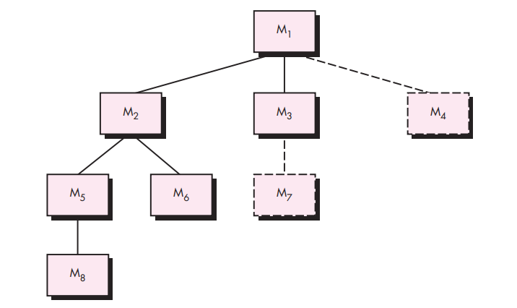
Top-Down Integration

Slide 15
Top-Down Integration
1. The main control module is used as a test driver and stubs are substituted for all components directly subordinate to the main control module. 2. Depending on the integration approach selected (i.e., depth or breadth first), subordinate stubs are replaced one at a time with actual components. 3. Tests are conducted as each component is integrated. 4. On completion of each set of tests, another stub is replaced with the real component. 5. Regression testing may be conducted to ensure that new errors have not been introduced.

